Slide 1
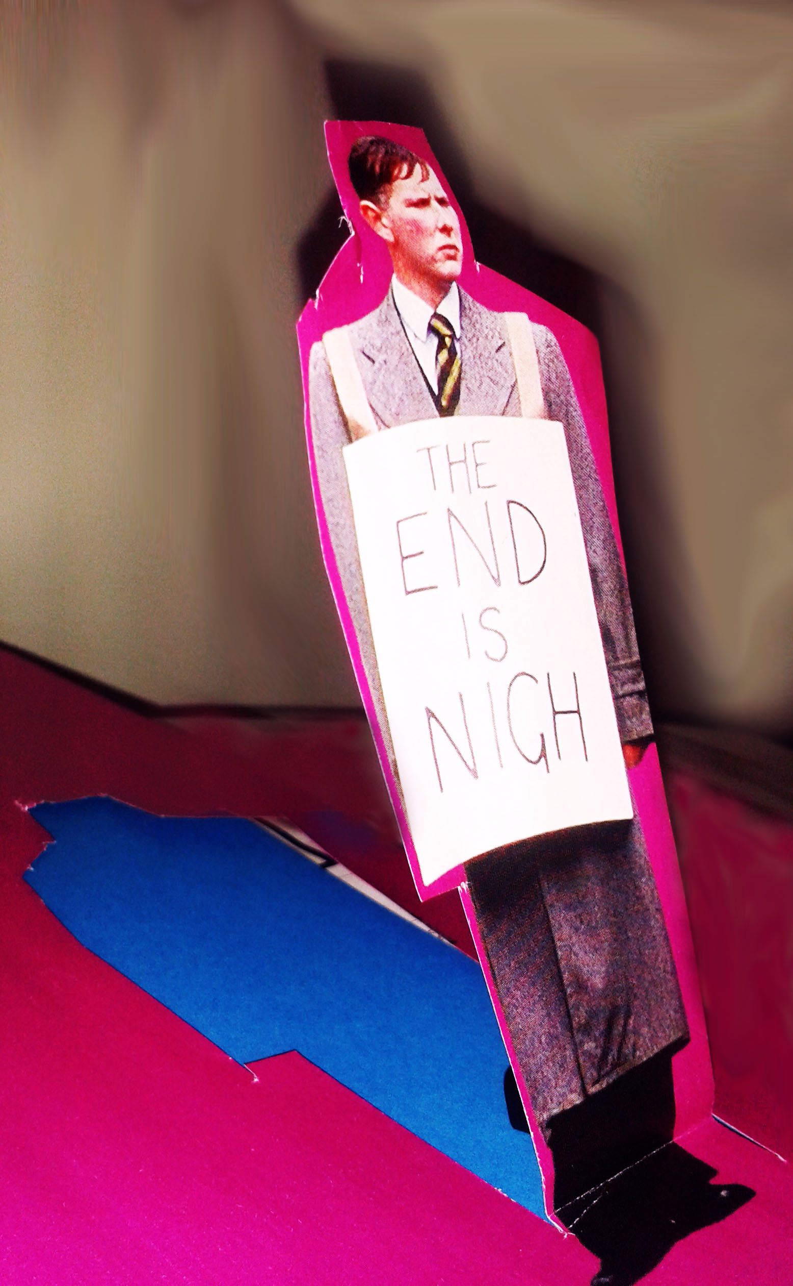
LCF Green Academy
The GA programme formed a network of HEIs, and offered support from the HEA and external specialists to enable teams to embed sustainability across the institution with particular emphasis on ESD.
Lightening the Load: creating change for sustainability through fashion education
How might we rethink the university experience to create a space that allows students and staff to be experimental, critical, global, interdisciplinary and collaborative?

Slide 2
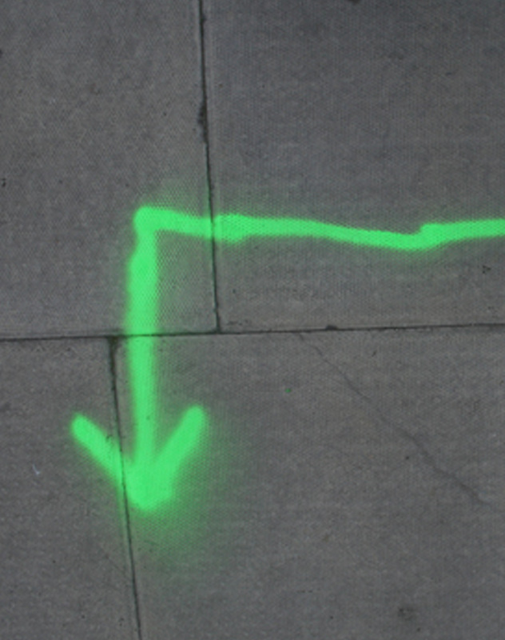
Aims and objectives
Core strategy commitment to sustainability – show leadership in ESD in art and design education
Sustainability in every student experience – Engage participation across the college
Sustainability as a connecting system – embed a systems thinking approach
Communicating a culture of sustainability practices – look at ways for capturing and measuring

Slide 3
From branch to root
The GA has had the support and commitment from the PVC and representatives from each of the schools were appointed to be part of the LCF GA team and contribute to realising aims.
Challenges:
Mobilising staff engagement
Lack of ownership in and out of GA team
Successes:
LCF Sustainability Strategy team
LCF Sustainability Officer role
Notes:
Through identifying gaps Sustainability Officer role created , support LCF plans and ensure implementation through action

Slide 4
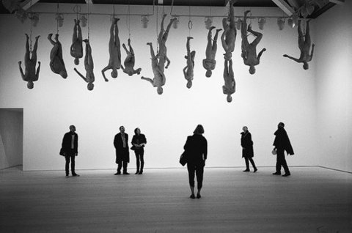
Bespoke journeys
Find ways of embedding sustainability opportunities into every student’s experience through formal and informal curriculum.
This started with mapping the points of opportunity for students to engage with sustainability in their LCF experience.
Challenges:
Paths to embedding in formal curriculum
Widespread student engagement
Successes:
Creation of Evolving Fashion Student Society
Stronger links with Student Union
VSC sustainability prompts
Student led activities – eg Fashion revolution
Notes:
Designed to help course teams gong through validation/revalidation to be specific about engagement with sustainability and aspirations

Slide 5
Systems of people and places
GA enabled a sharing of best practices across a network of higher education institutions and highlighted the importance create a greater sense of connectivity within and outside the college.
Challenges:
Creating a sense of community for staff and students
Engaging with the GA network in a meaningful way
Successes:
Development of social responsibility initiative and review of community engagement
LCF College Conference on Sustainability
UAL Teaching and Learning Day
MA Fashion Futures Story gathering
Notes:
Director of social responsibility - created to foster collaboration with diverse and hard to reach communities- eg work with womens prisons to develop knowledge exchange

Slide 6
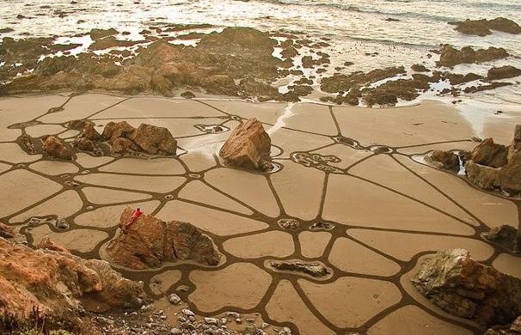
Next steps
How can we transform art and design education at UAL so that sustainability is a core part of our culture and practice?

