Slide 1
ISPN

Slide 2
Programme
Welcome and context of CoP -
“RE-search project” – Gary Campbell, CSM
“S. Log” – Jane Penty, CSM
“Critical Mass” & “Survival 2014” – Sarah Temple, LCC
“The Green Academy” @ LCF – Centre for Sustainable Fashion
“Communication Design for Sustainability” – Joana De Oliveira Casaca E Lemos, CSM
“Sustainability in the Curriculum” – Antony, CLTAD
Quality Enhancement Booklet
Themes for Next Year
Funding Opportunities, Events & Eval.

Slide 3
QE Booklet
Photo by Herbythyme CC BY-SA 3.0 / Cropped from original
Sustainability in the Curriculum

Slide 4
Paradigmatic Approaches

Slide 6
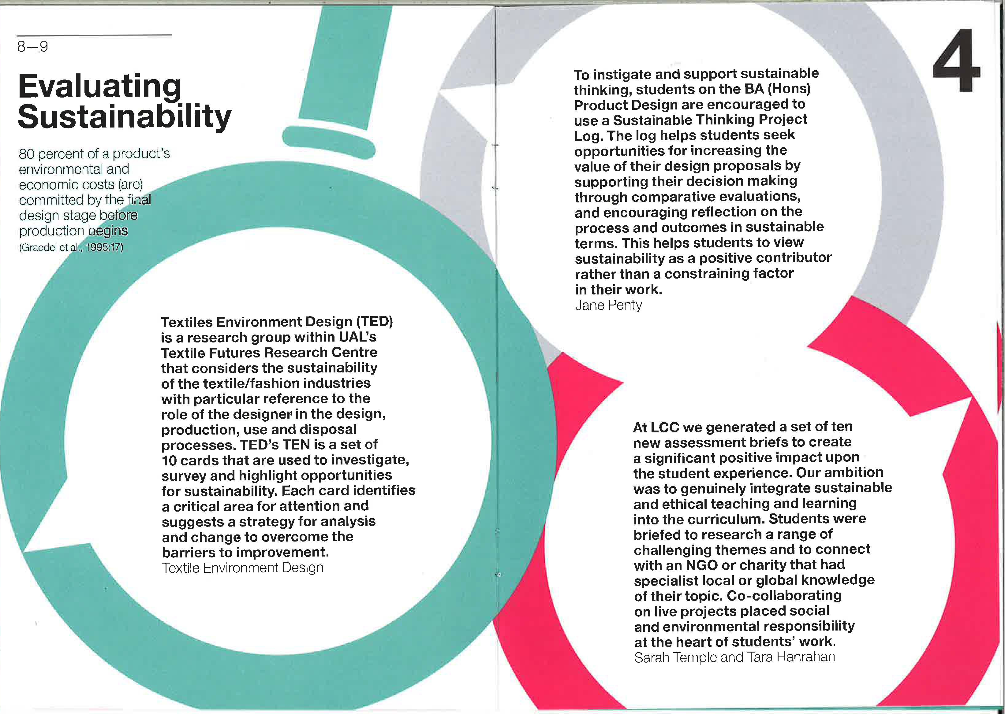

Slide 7
Curriculum Development
Sustainability projects should address one or more themes:
Develop Sustainability Literacy
Pedagogy for Sustainability
Sustainability of Learning Resources
Careers and Sustainability
Sustainability Competencies
Deadline – 19th September
Project awards £3000
Workshop Thursday 1pm, HH Lecture Theatre

Slide 8
Further Info & Support
NTF – 6th October
Enterprise and Employability – Cara Lee Roth, SEE
Amanda Johnston, LCF
Cath Caldwell, CSM
Ellen Hanceri, LCC
Katrine Hjelde, CCW
Everything Else - Antony Johnston, CLTAD
Keep informed about upcoming opportunities by subscribing to CLTADs mailing list: http://bit.ly/1myTms3

Slide 9
What next?
Photo by Herbythyme CC BY-SA 3.0 / Cropped from original

Slide 10
What themes would you like addressed next year?
What should the CoP do?
How can you contribute?
What are your evaluative thoughts re the CoP.
Please indicate if you came to 1 or 2 sessions this year.

Slide 11
End

