Slide 1
BA: Graphic and Media Design
YANG YANG

Slide 2
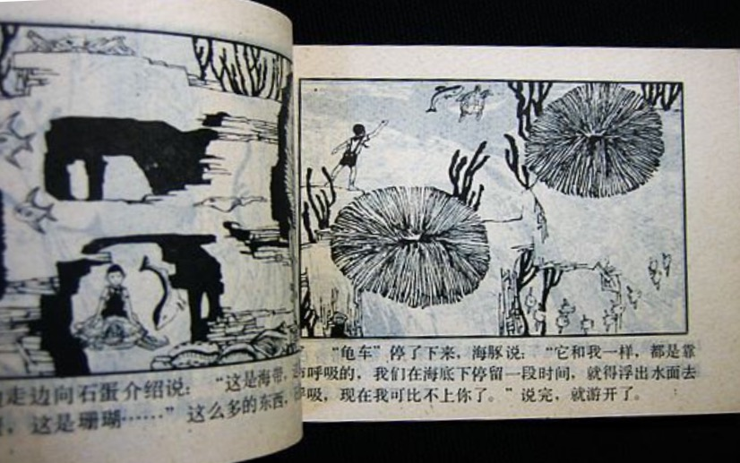
BINGDE WU, 1984, 《漫游万鱼国》

Slide 3
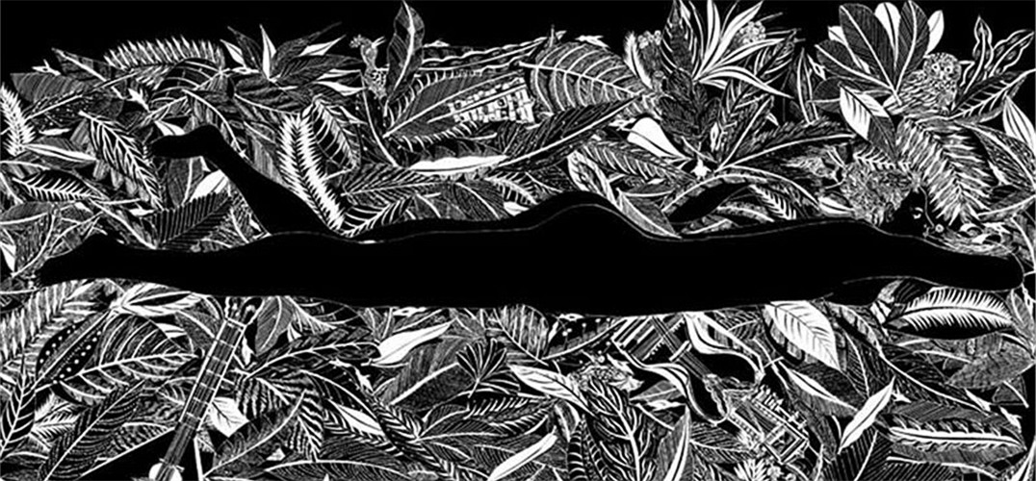
BINGCHUAN LENG, 2003, 菩提子

Slide 4
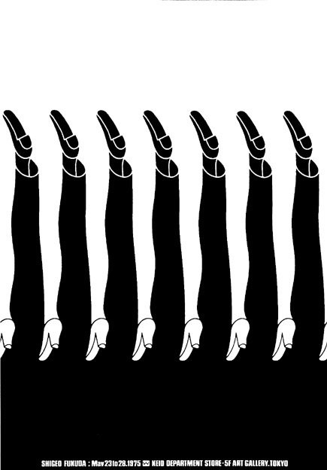
SHIGEO FUKUDA, 1975, Keio department store posters

Slide 5
SHIGEO FUKUDA, 1987, Shigeo Fukuda posters show

Slide 6
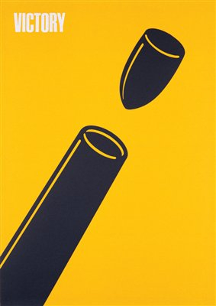
SHIGEO FUKUDA, 1975, Victory of 1945

Slide 7
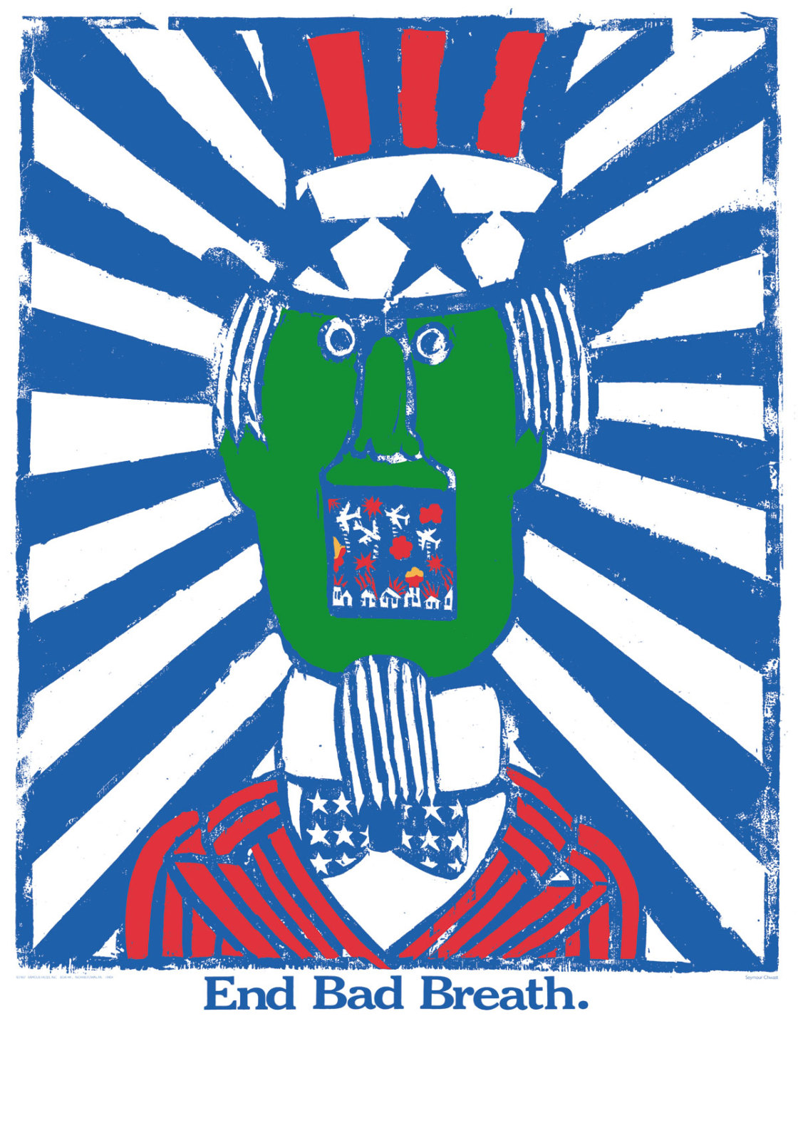
SEYMOUR CHWAST, 1968, End Bad Breath

Slide 8
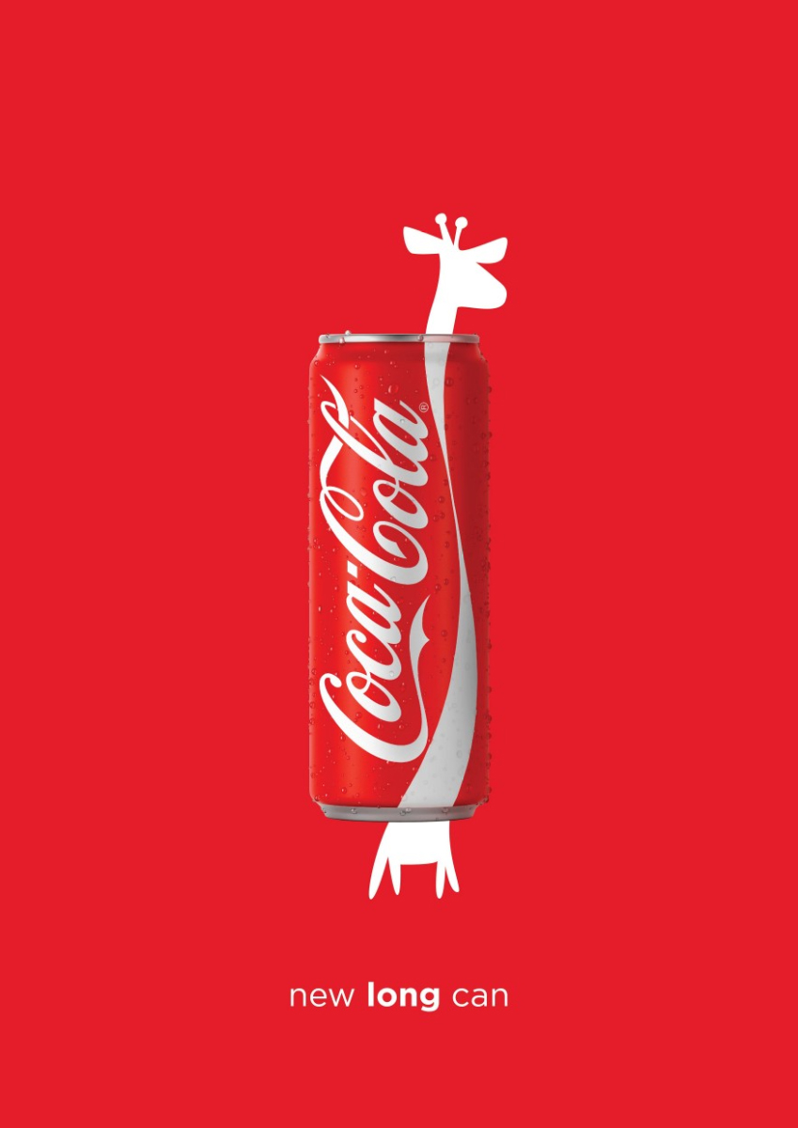
ESTUDIO1430, 2016, COCA-COLA: NEW LONG CAN (LEBANON)

Slide 9
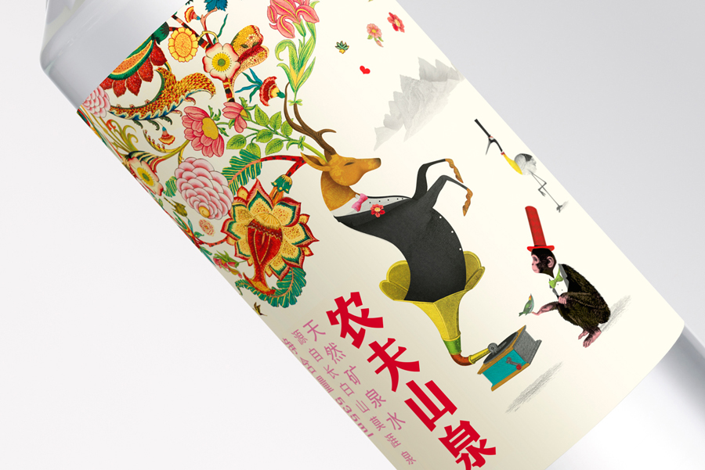
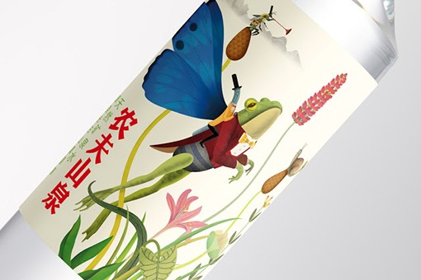
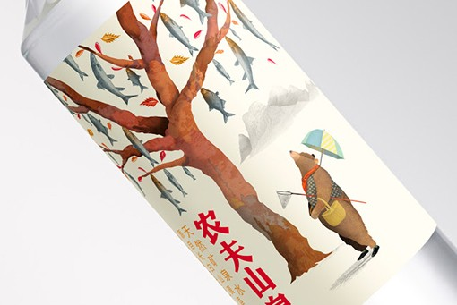
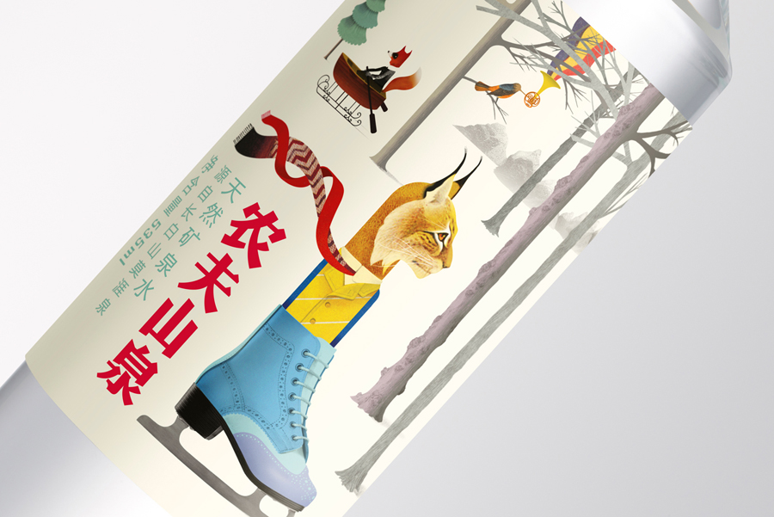
BREET RYDER, 2015, Nongfu mineral water packaging

Slide 10
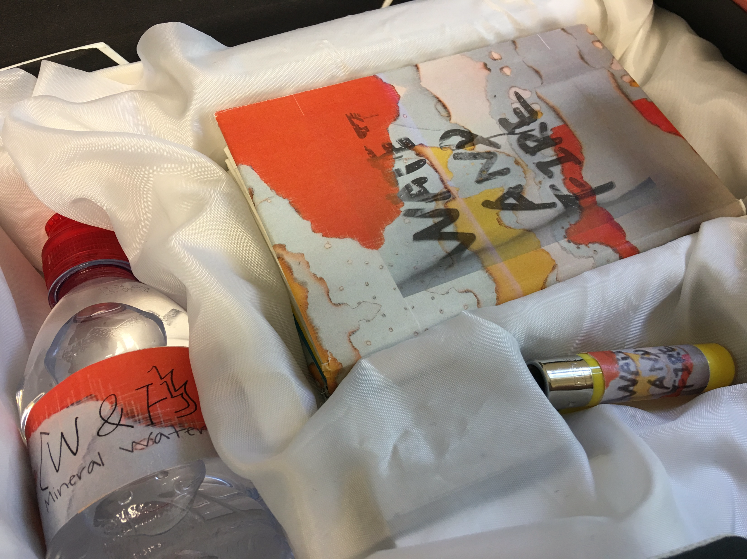

Slide 11
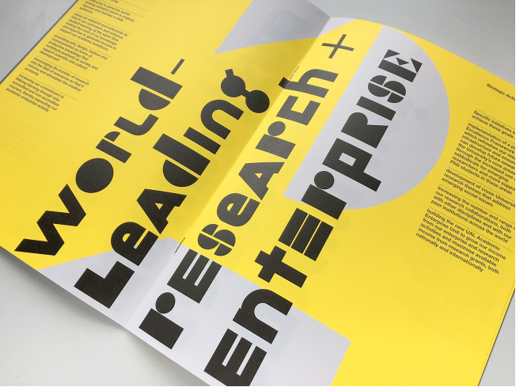
MuirMcNeil, 2015, University of the Arts London

Slide 12
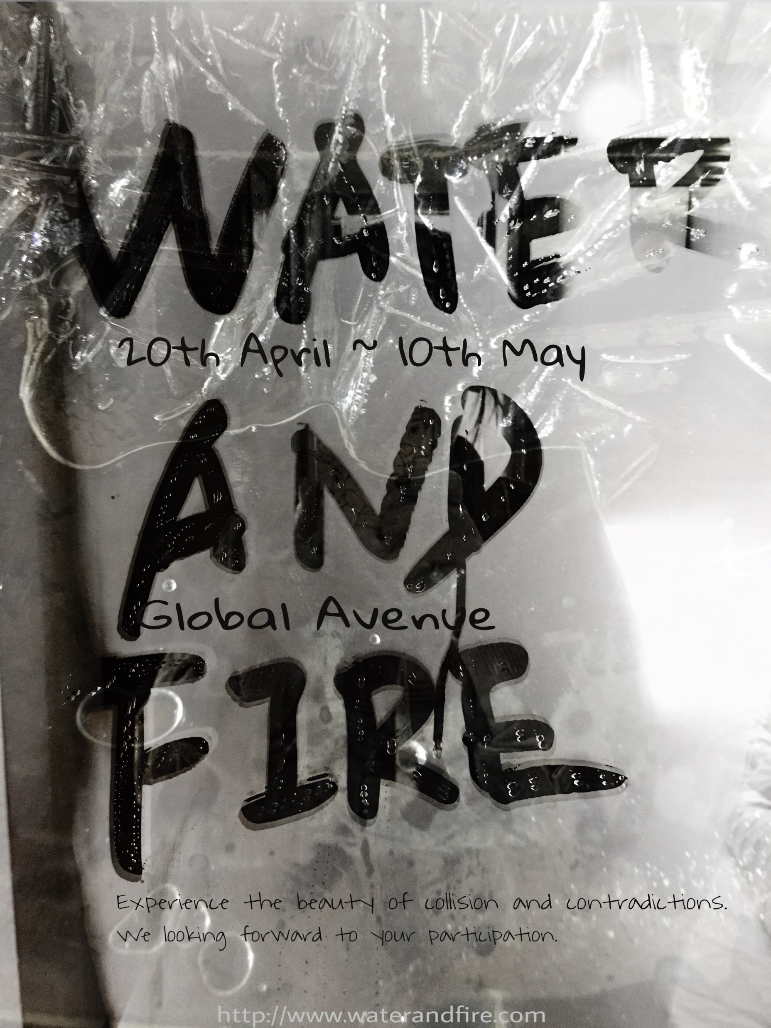

Slide 13
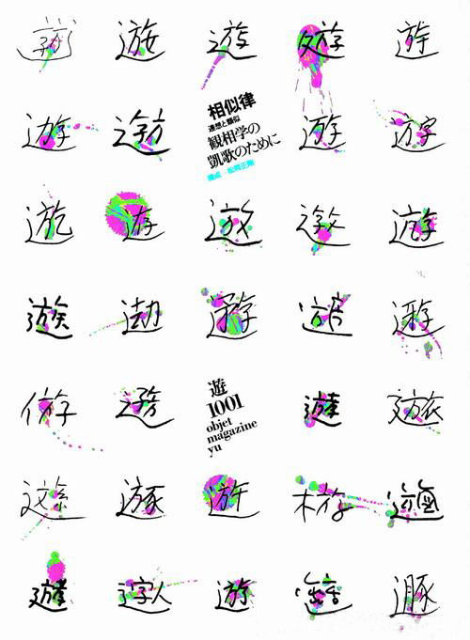
Kohei Sugiura, 1975, 《遊》August Issue

Slide 14
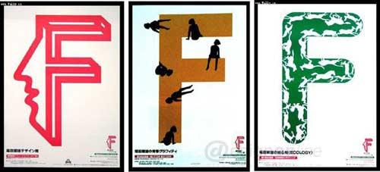
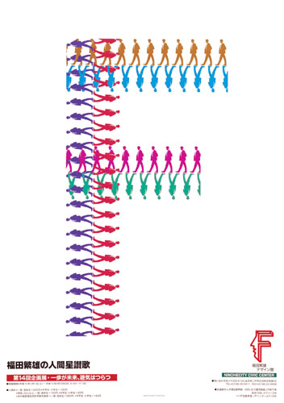
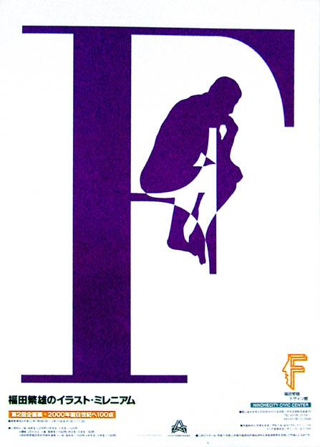
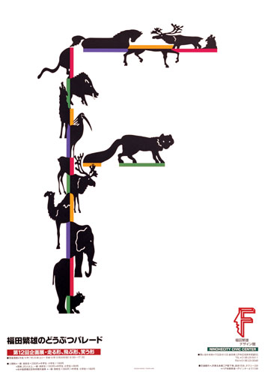
SHIGEO FUKUDA, Unkown, 《F》

Slide 15
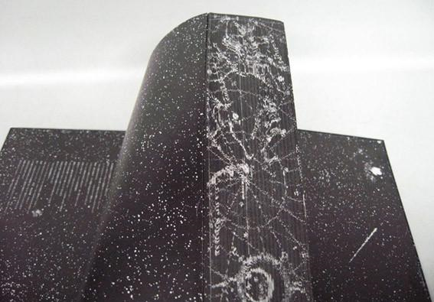
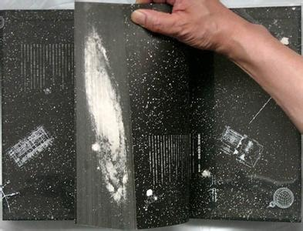
Kohei Sugiura, 1979, 《全宇宙誌》

Slide 16
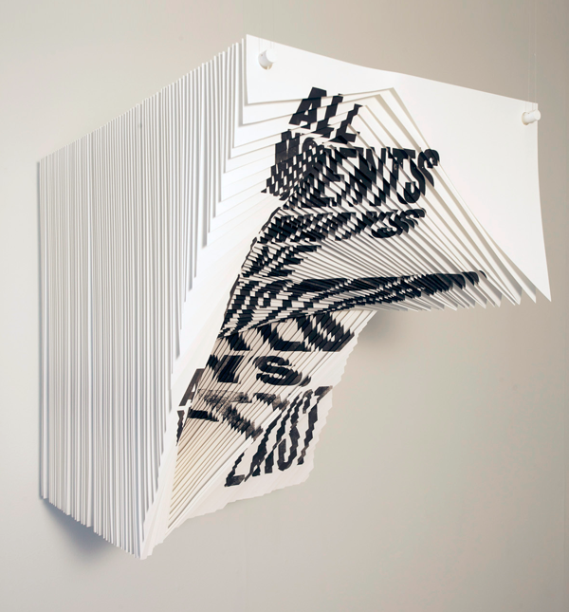
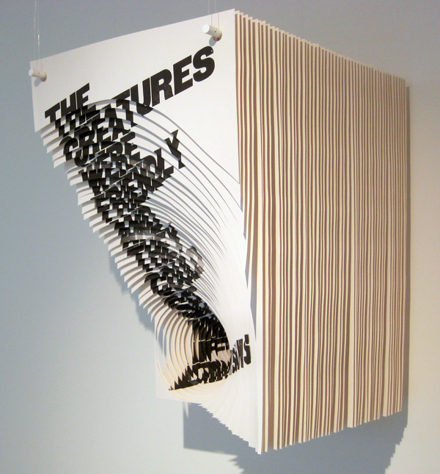
ALIDA SAYER, 2010, There is not why

Slide 17
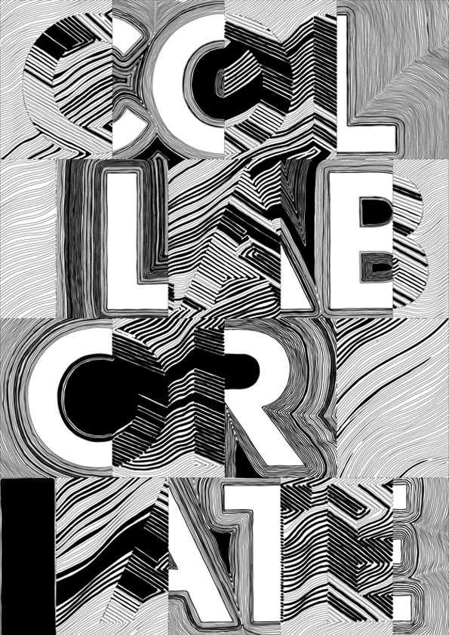
KOOS BREEN & SUZANNE BAKKUM, 2013, Collaborate

Slide 18
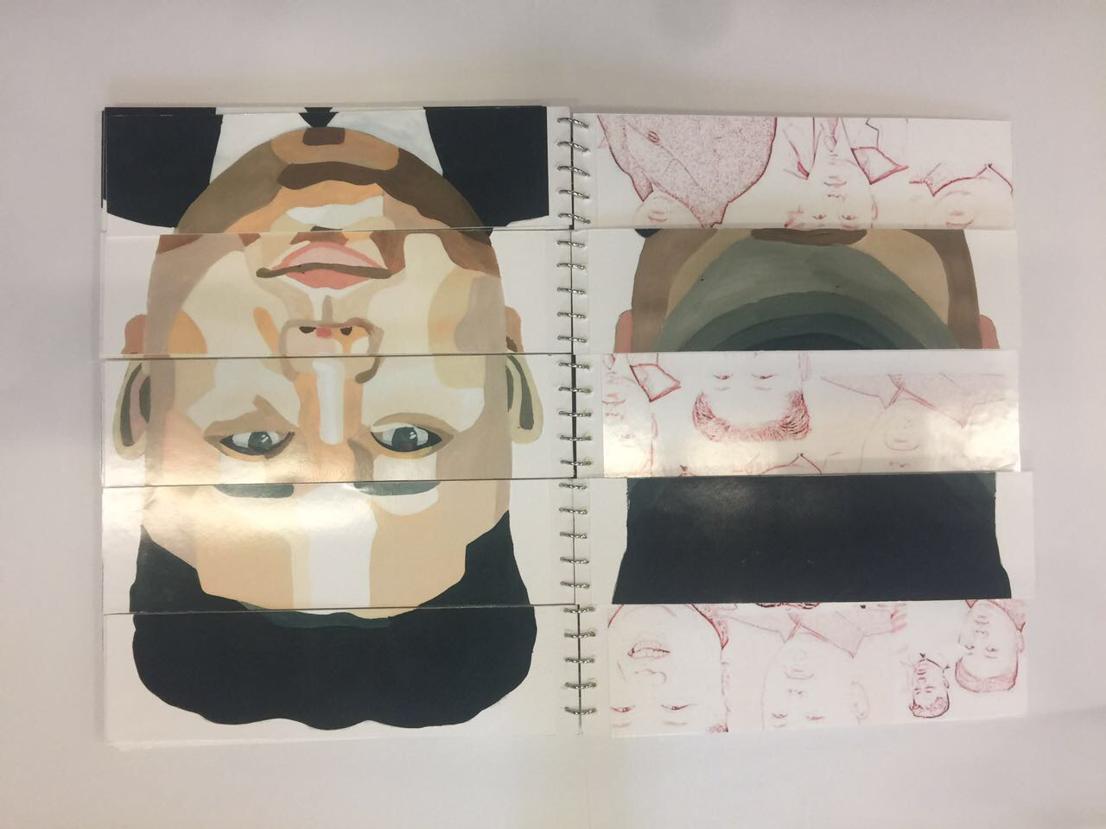

Slide 19
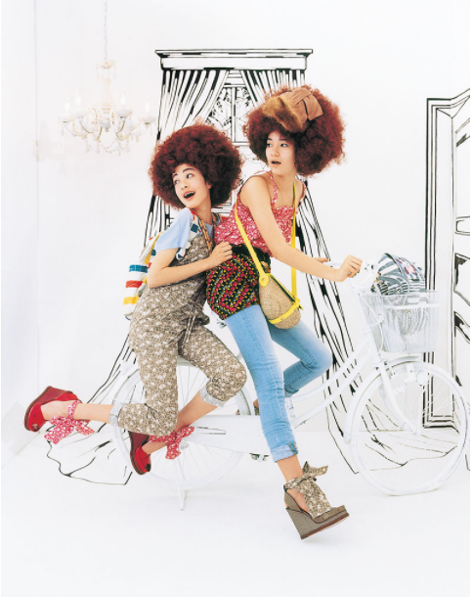
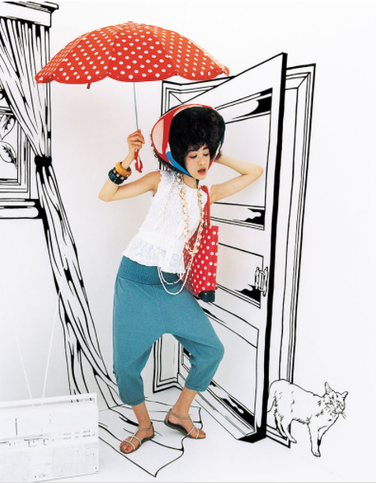
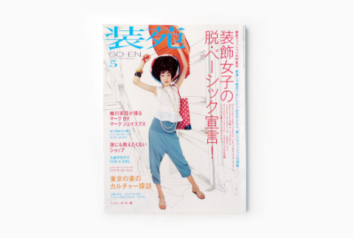
KIYOSHI KURODA, Unknown, 装苑

Slide 20
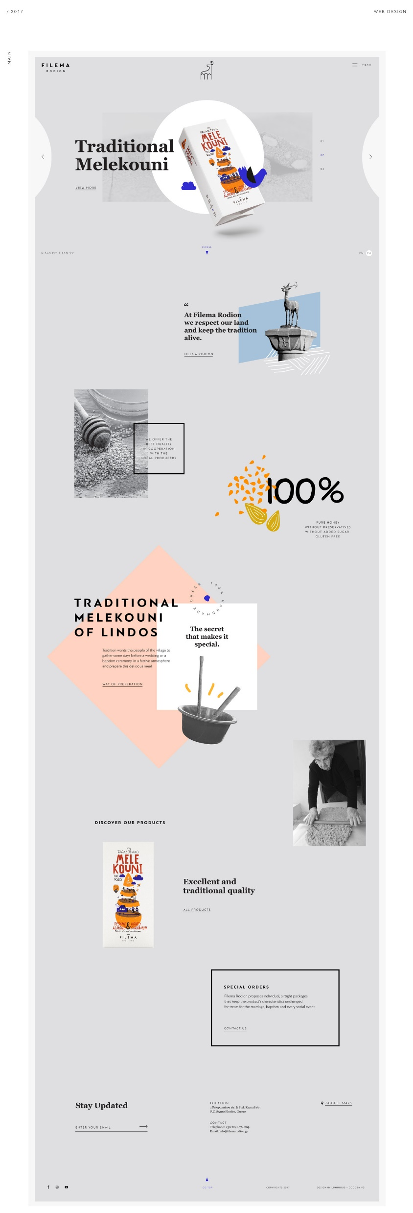
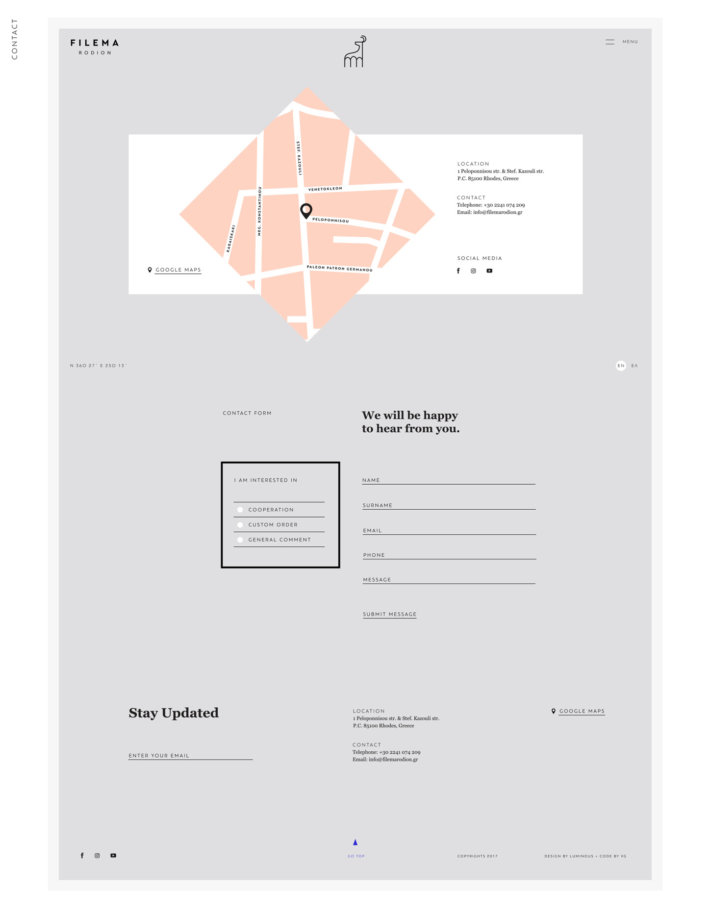
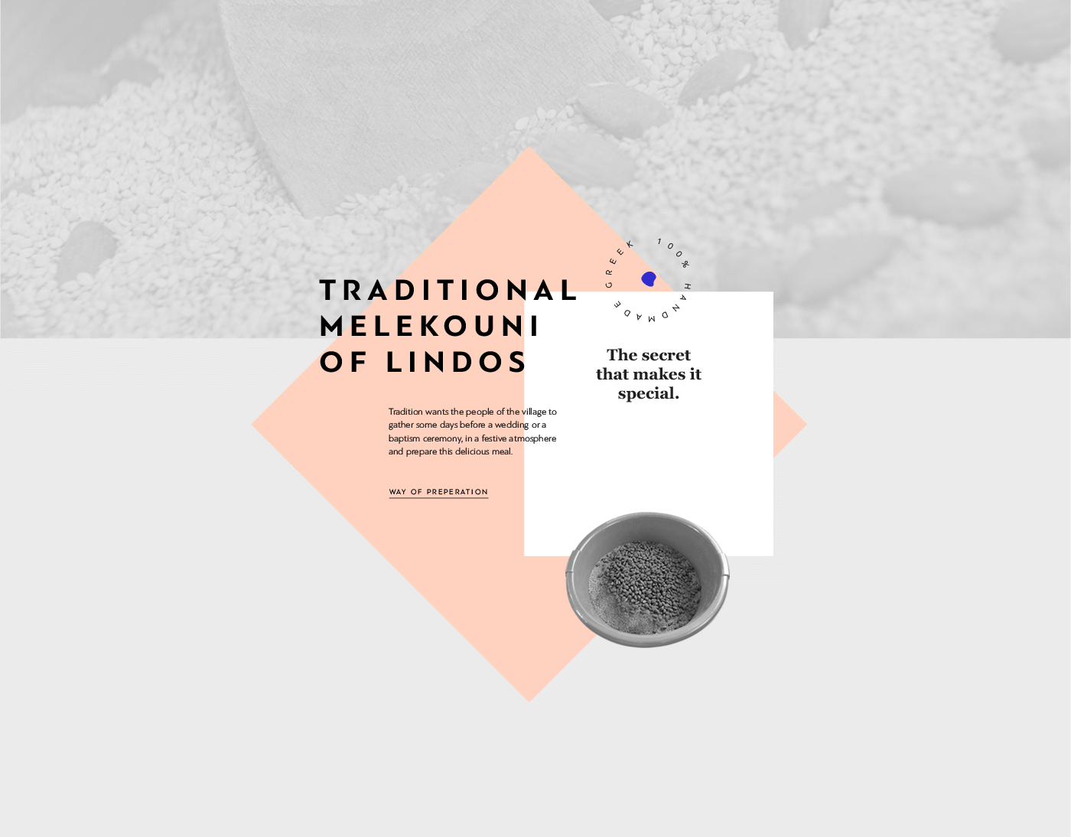
LUMINOUS DESIGN GROUP, Unkown, Filema Rodion Web

Slide 21
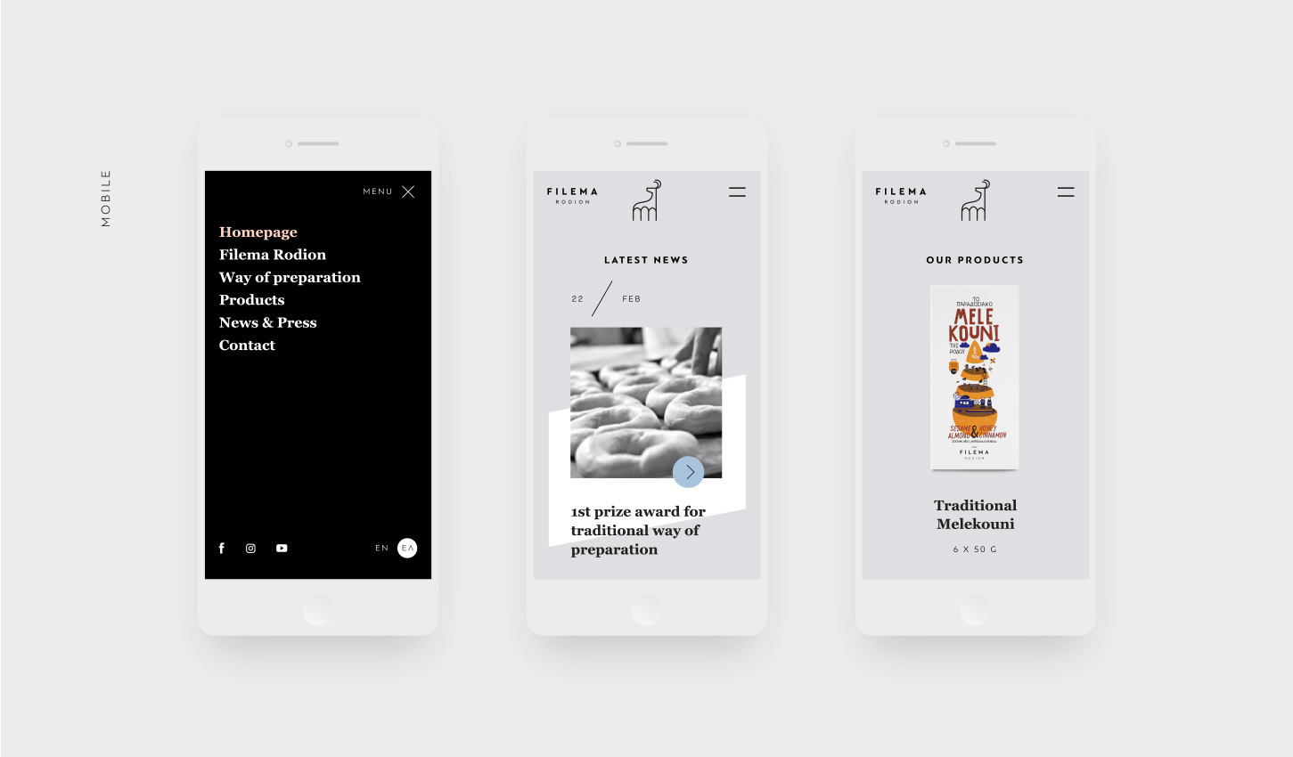
LUMINOUS DESIGN GROUP, Unkown, Filema Rodion APP

